Slide 1

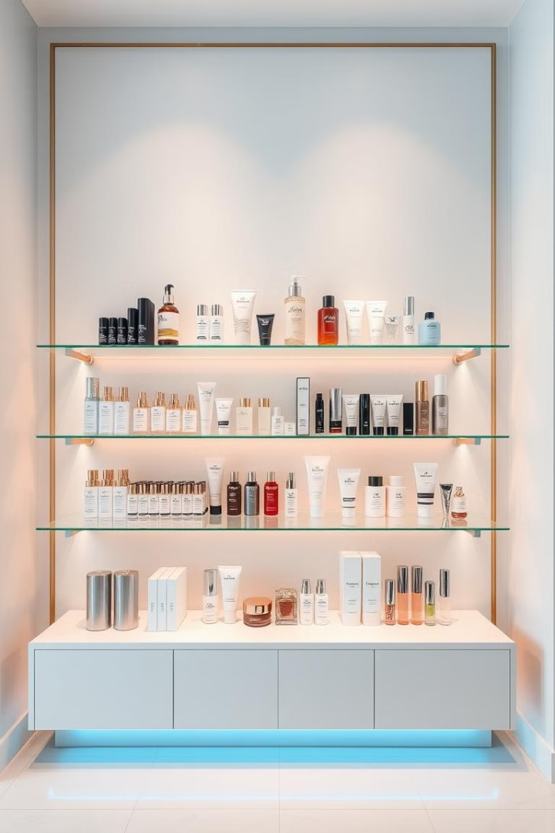

Streamlining Cosmetics with Oracle ERP
Explore how Oracle ERP can revolutionize the cosmetics industry. Discover the transition from manual processes to automated efficiency. See how ERP improves overall operations.

Slide 2
Group Team work
CEO
Shimaa Rabiea AbdElzaher
Inventory
Hady Mohammed Abdalsalam
Sabreen Shawky Hussien
Purchasing
Mohammad Rashad AboulWafa
Order Management
Ahmad Mohamad Yassen

Slide 3
Oracle Purchasing Module
Procurement Automation
Supplier Management
Streamline purchase orders and approvals.
Track supplier performance
Enhance efficiency and reduce errors.
Manage contracts and compliance
Self-service purchasing options

Slide 4
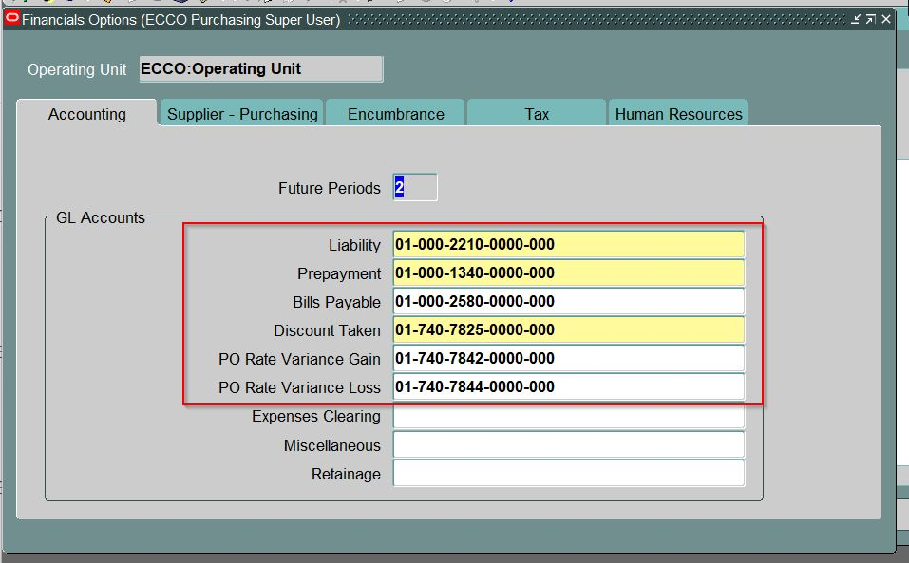
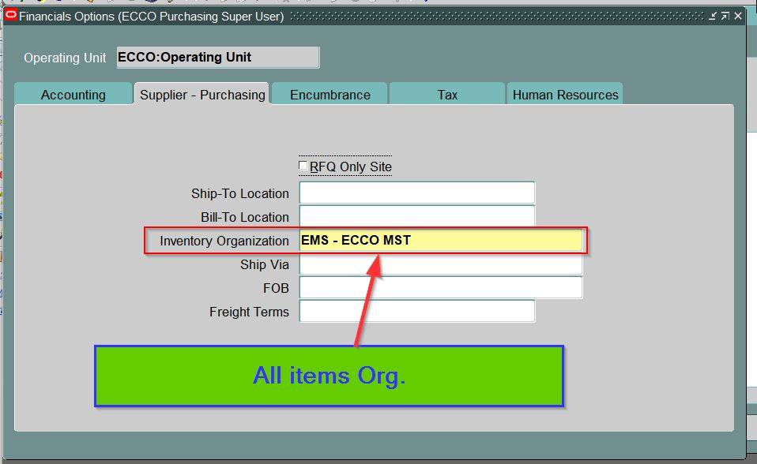
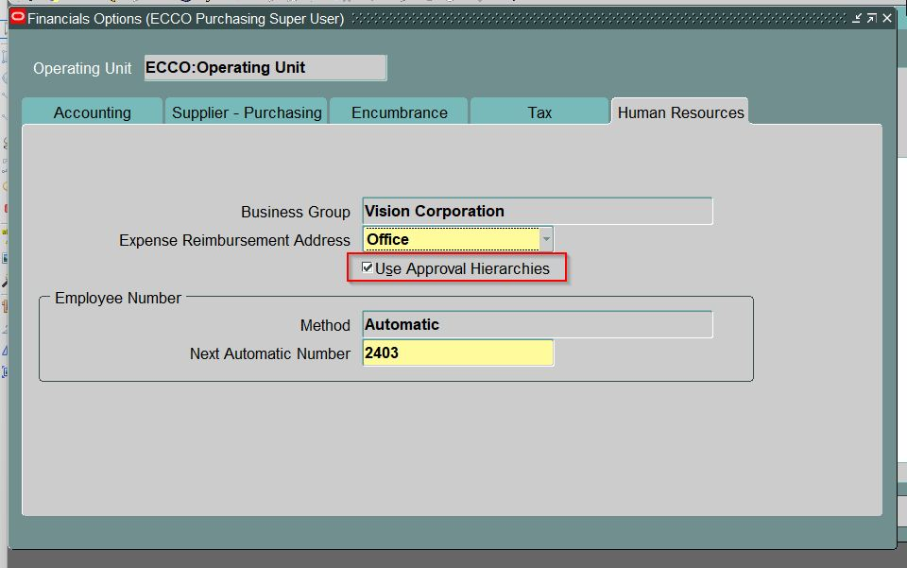
Oracle Applications - EBSDB

Slide 5
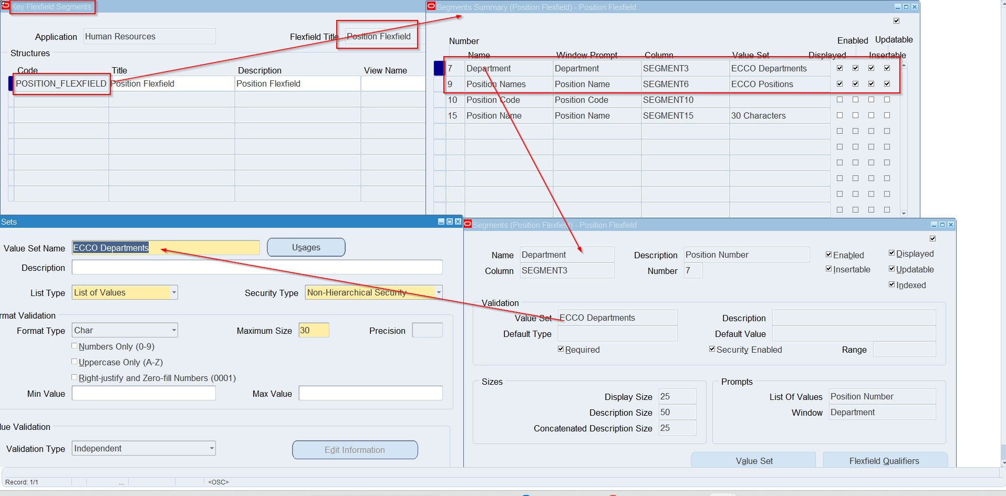
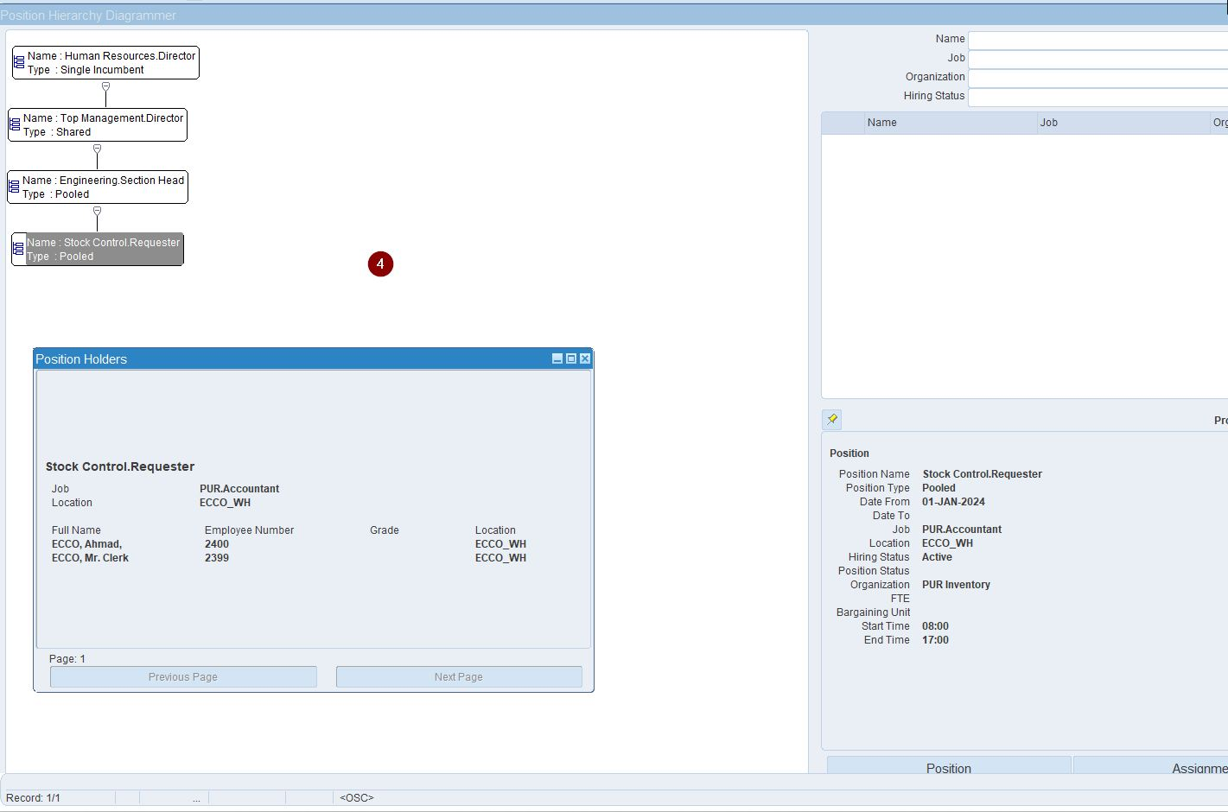
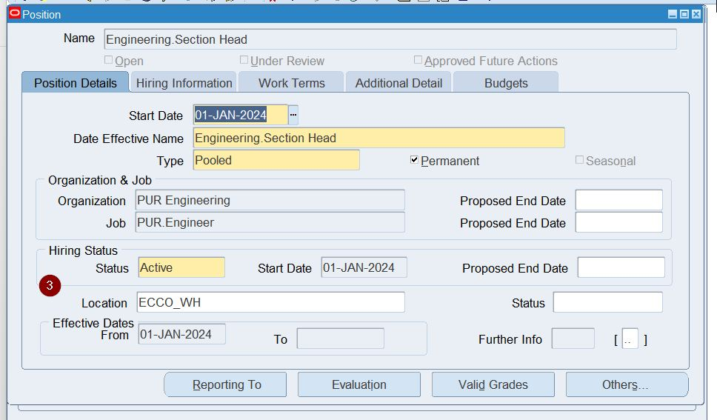

Slide 6
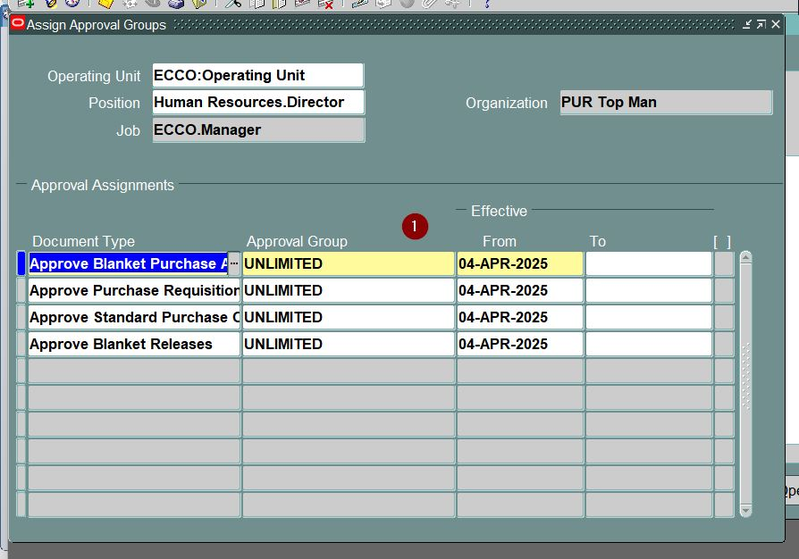
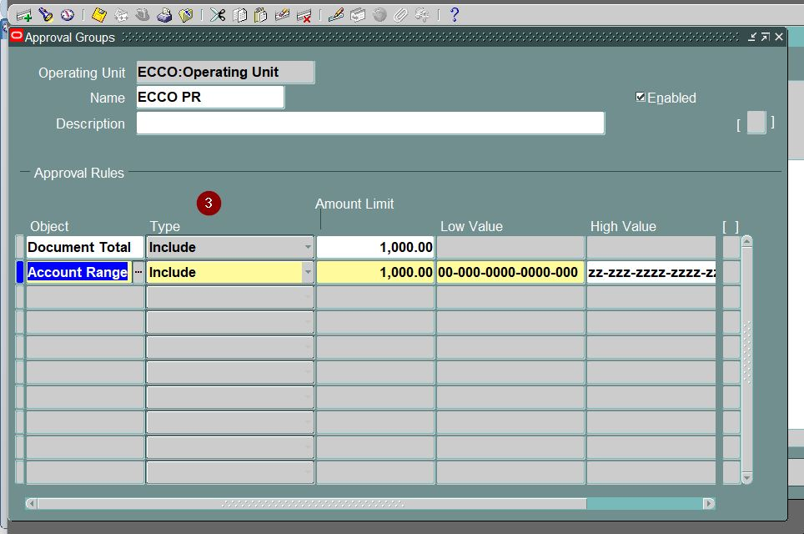
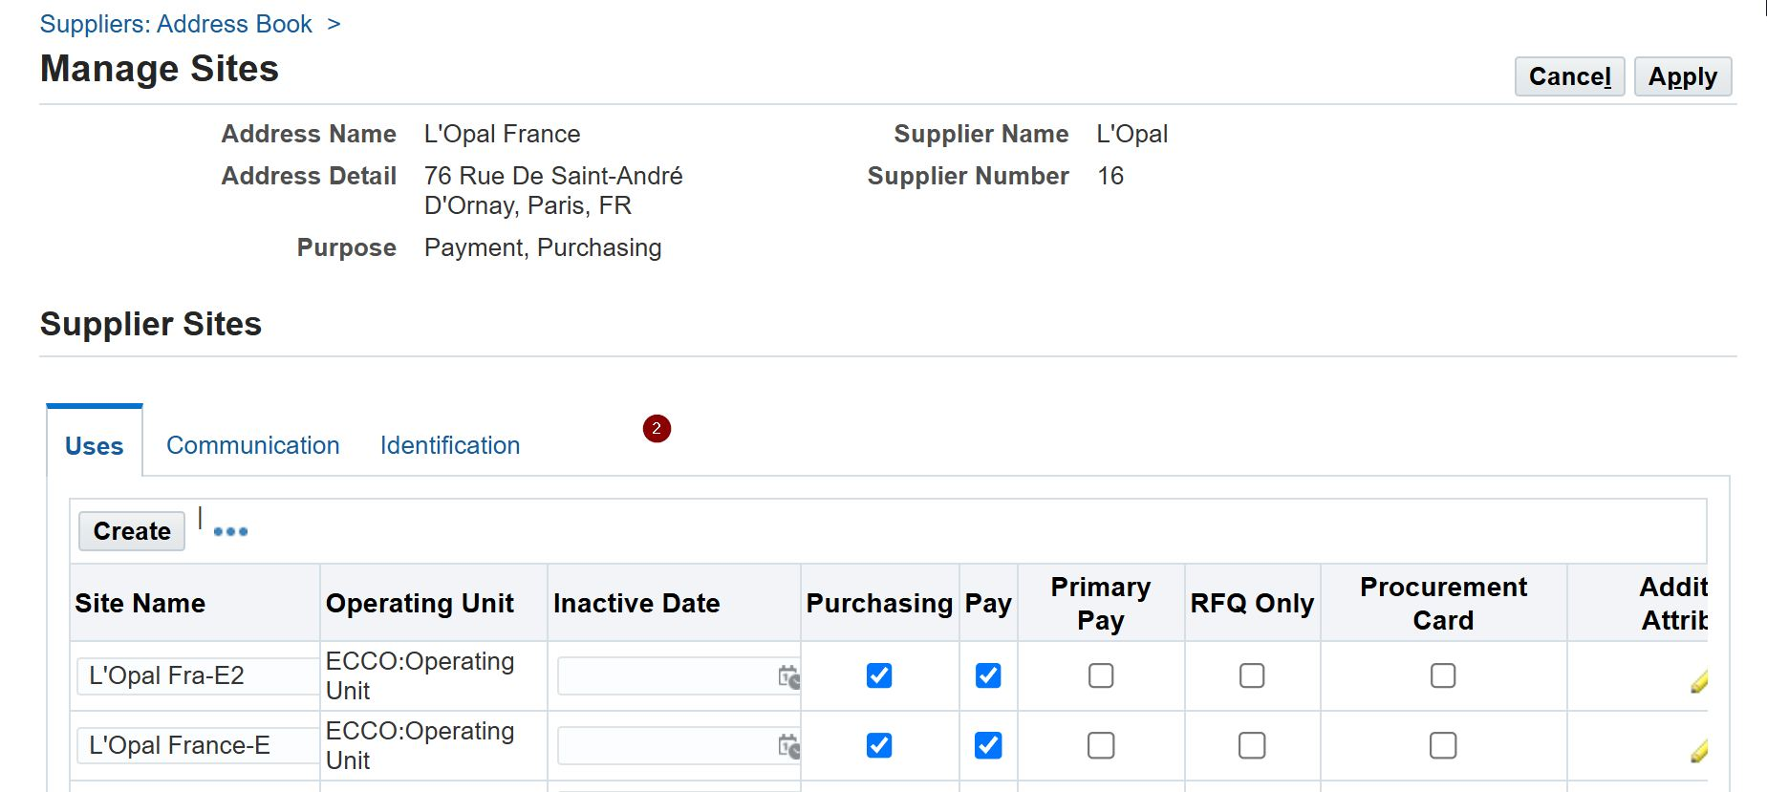

Slide 7
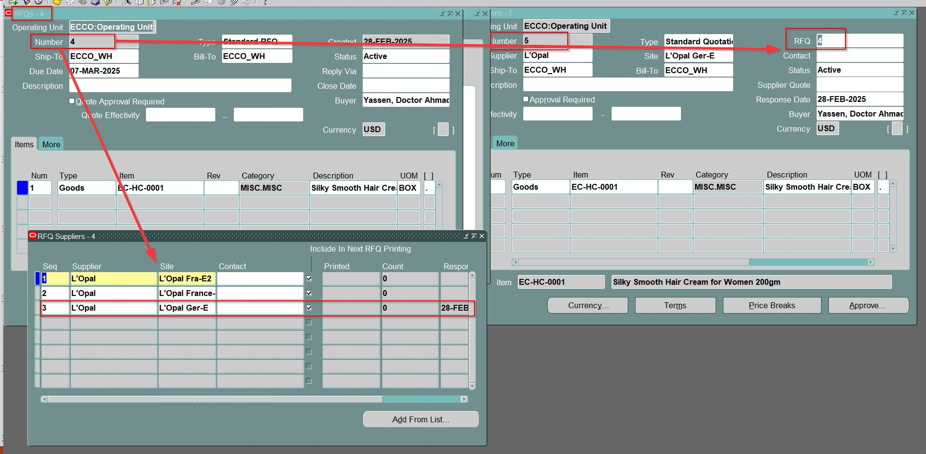

Slide 8
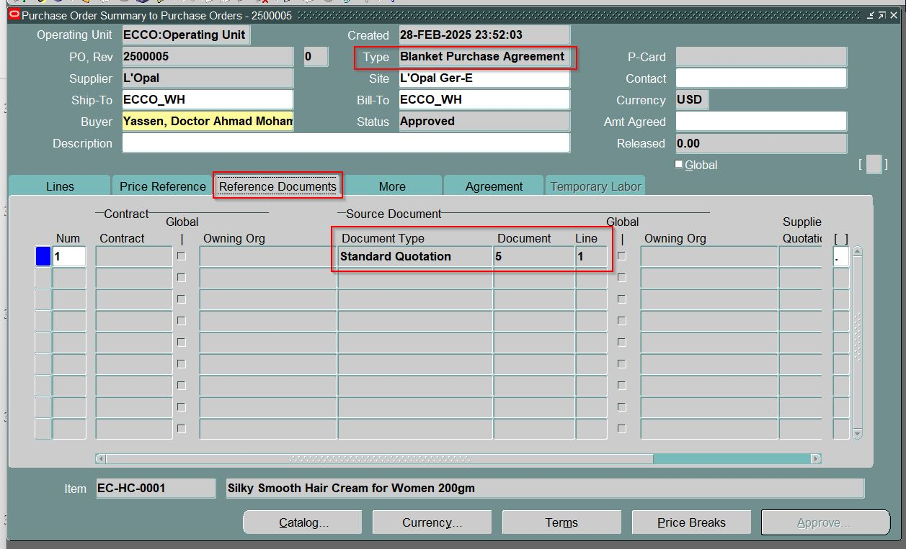

Slide 9
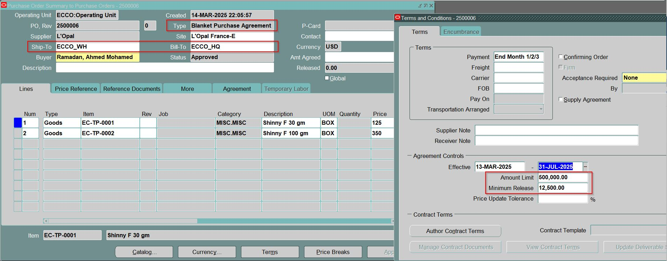
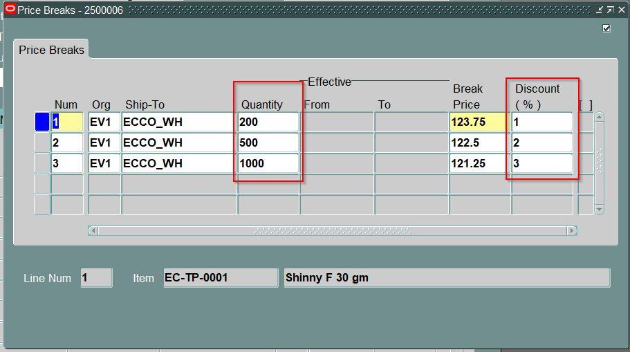

Slide 10
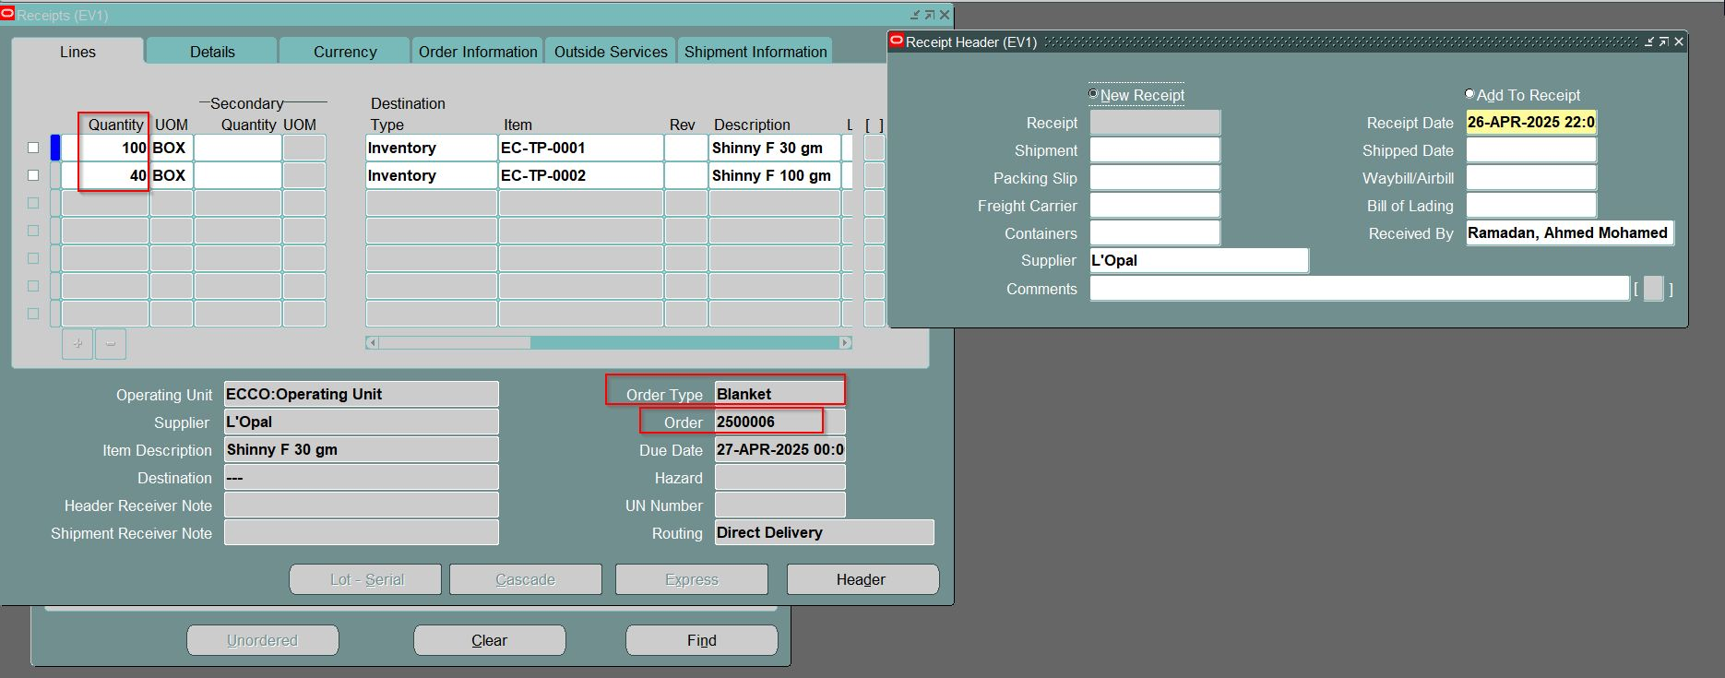

Slide 11
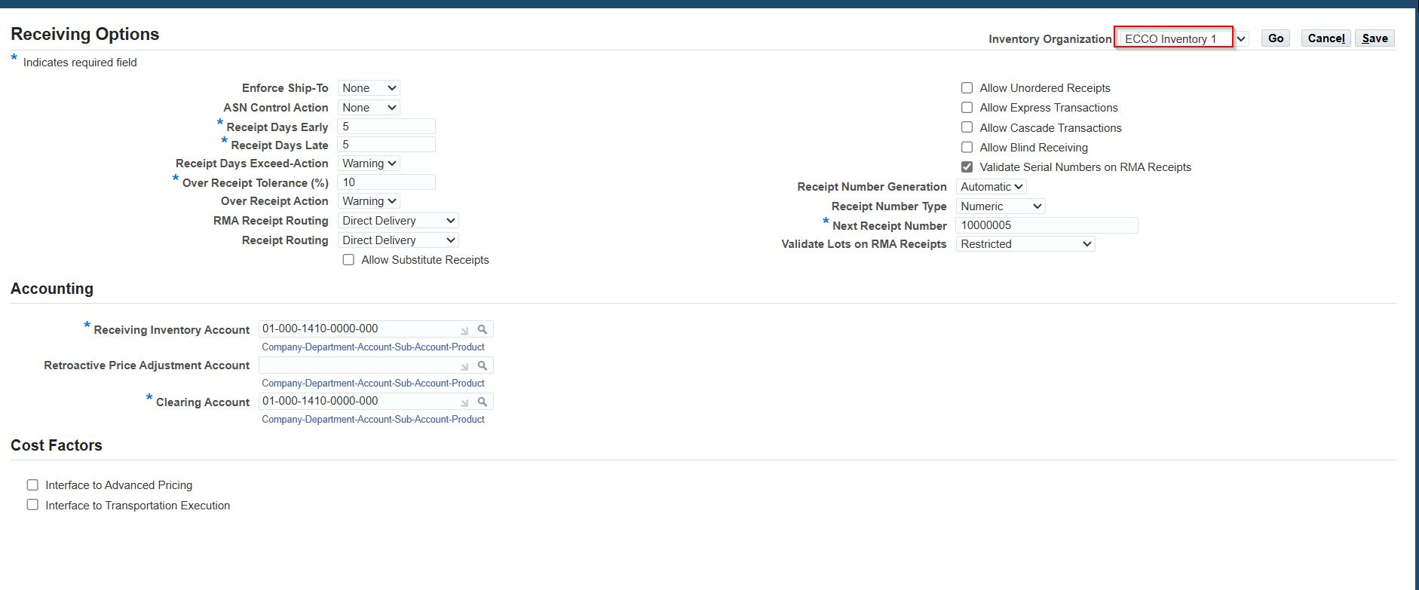

Slide 12
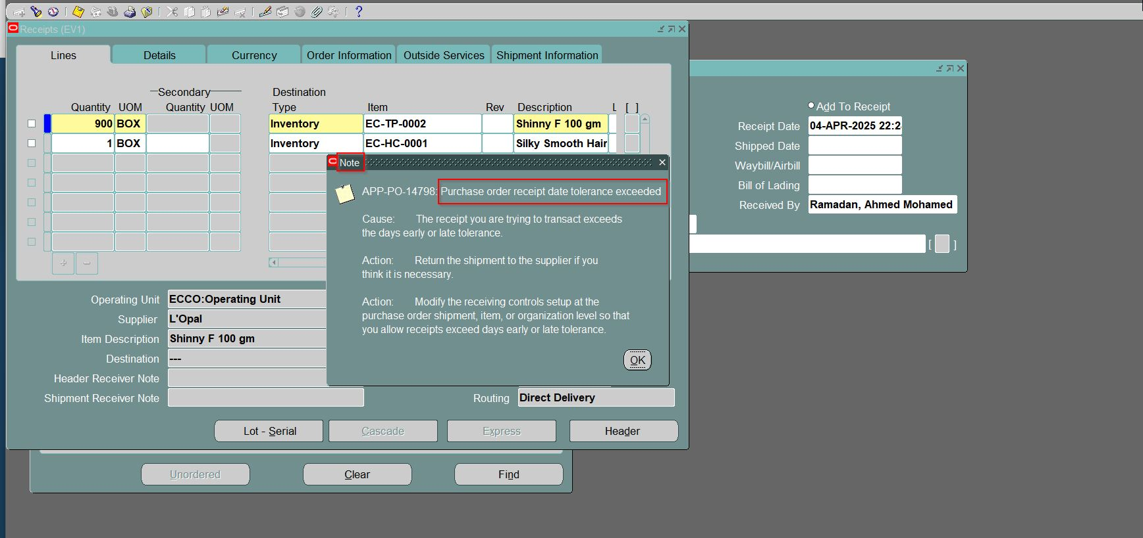

Slide 13
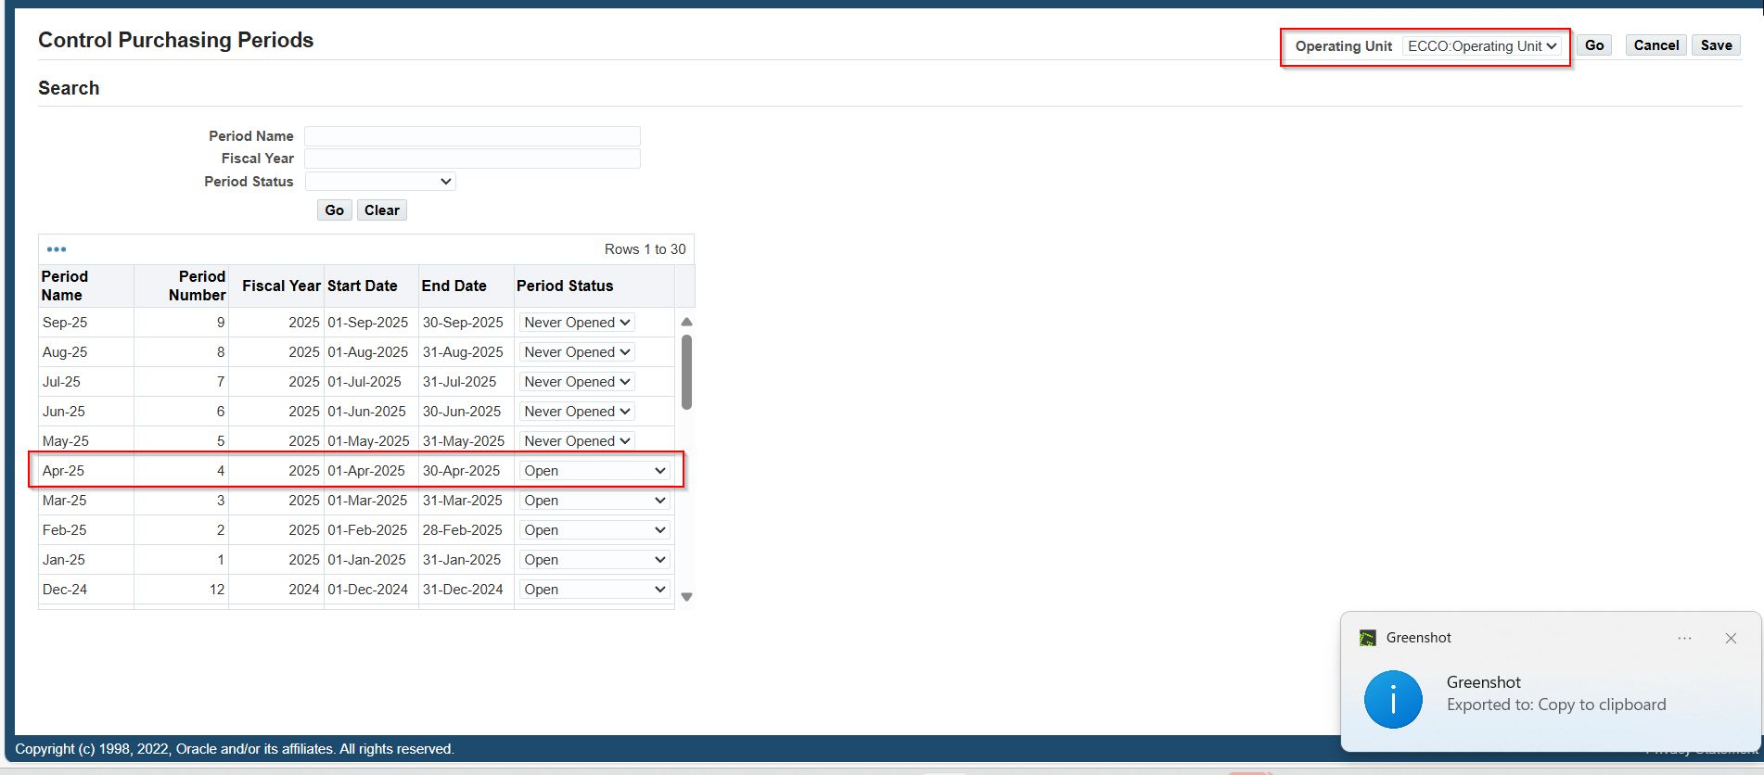

Slide 14
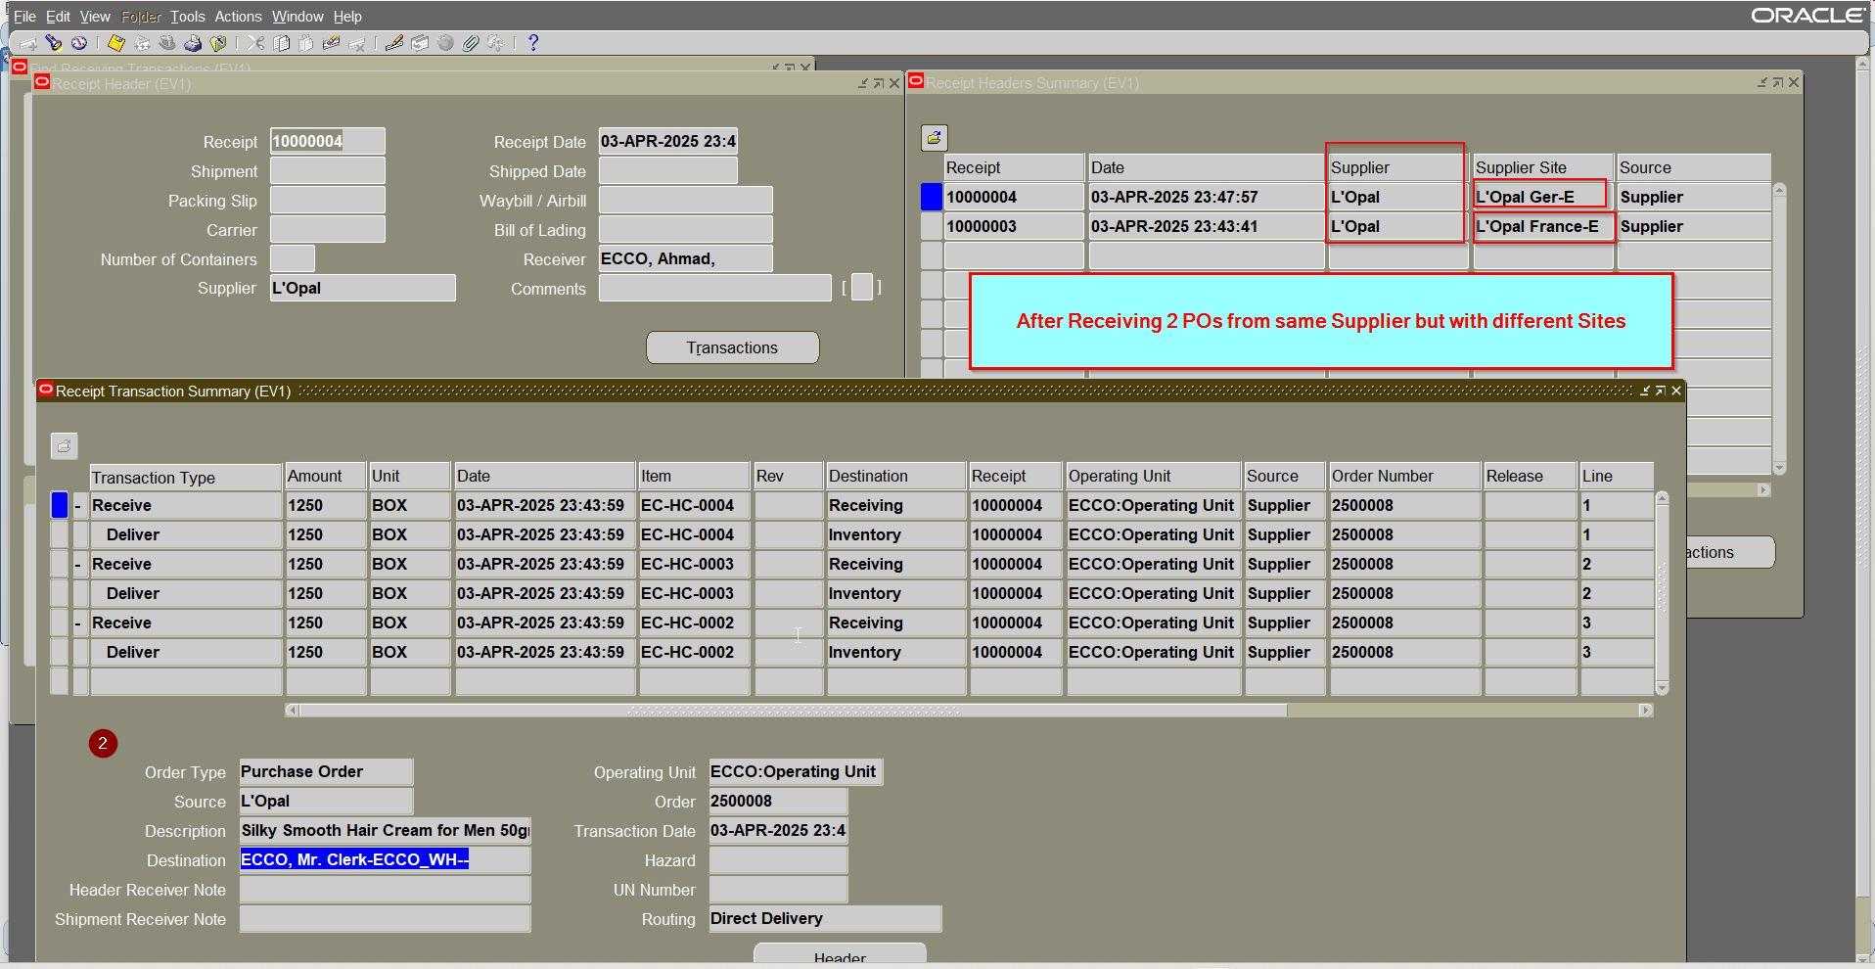

Slide 15
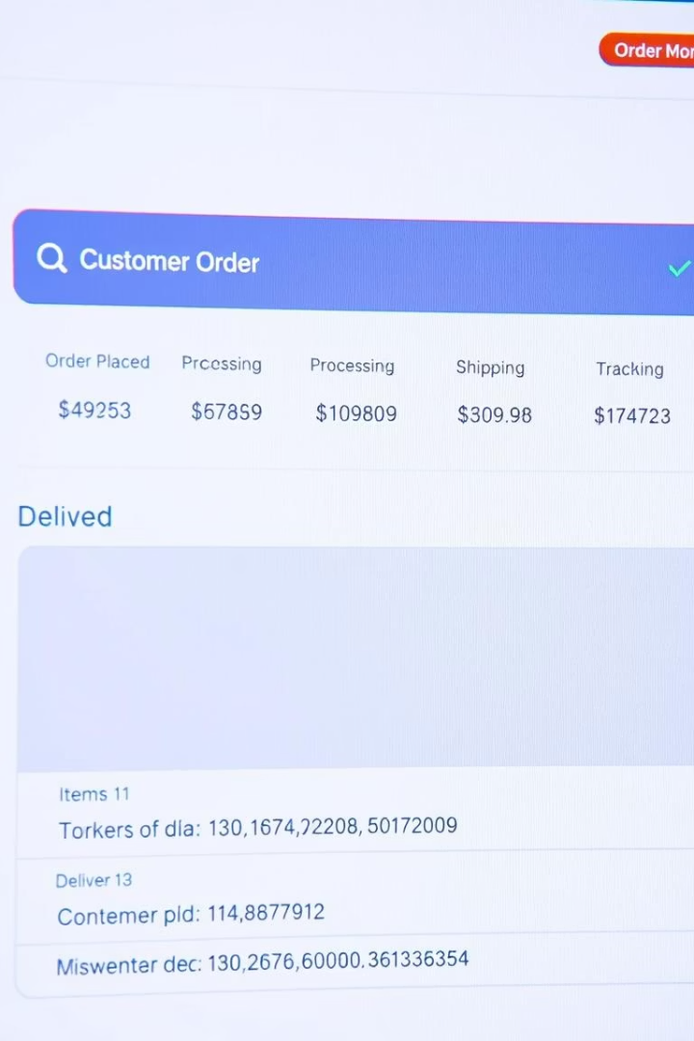




Oracle Order Management
Order Entry
Accurate and configurable capturing process.
Pricing & Discounts
Manage competitive pricing with flexible discounts and promotions.
Shipping Management
Efficiently handle delivery and logistics.
System Integration
Connect inventory and Purchasing seamlessly.

Slide 16
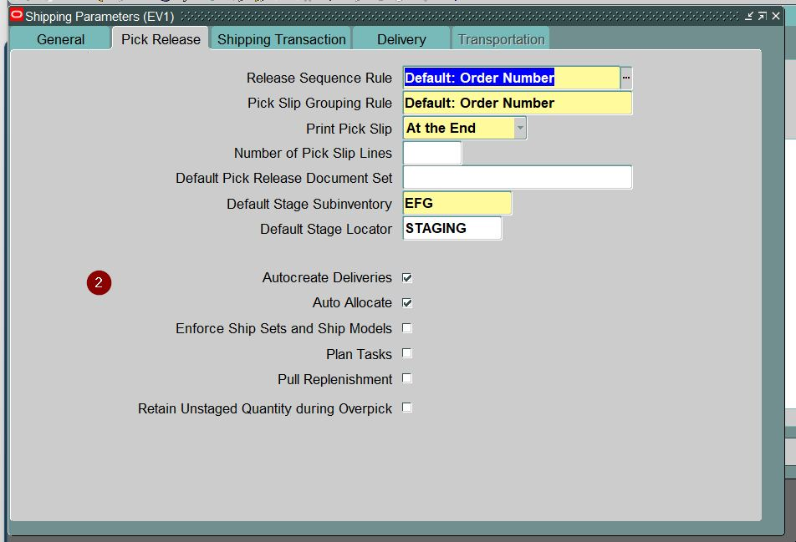
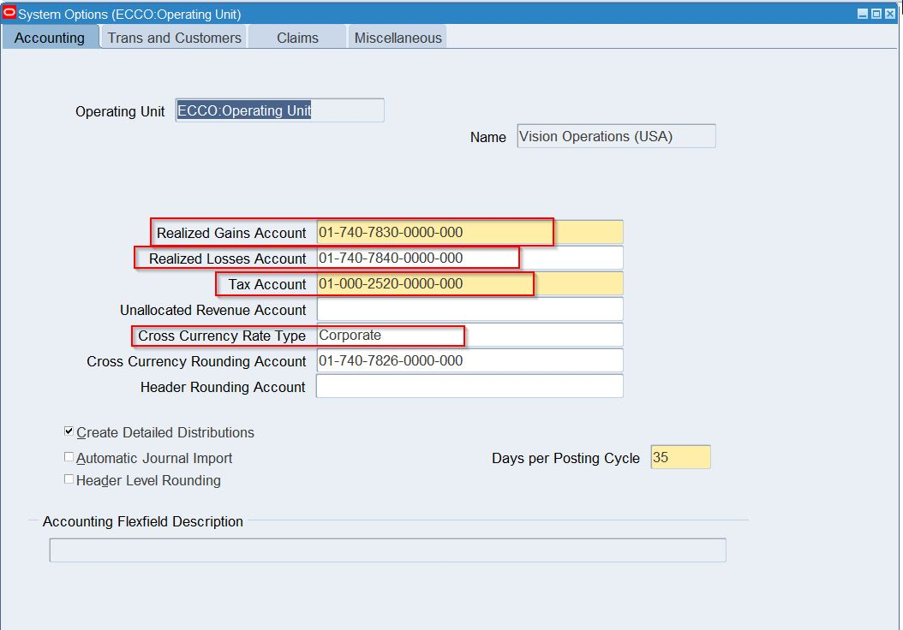

Slide 17
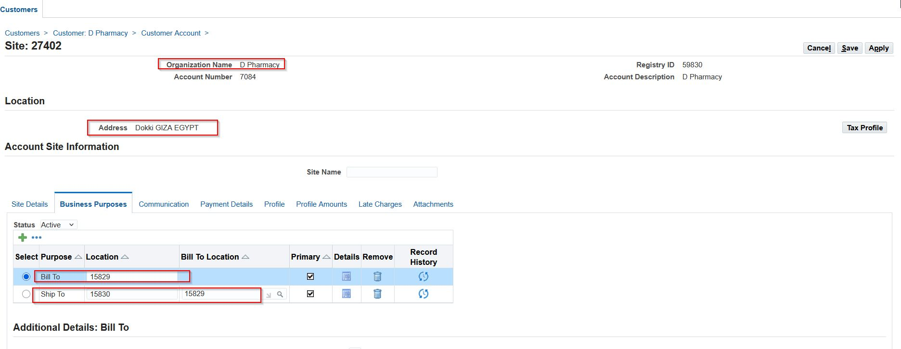
Site: 27402 — Mozilla Firefox

Slide 18
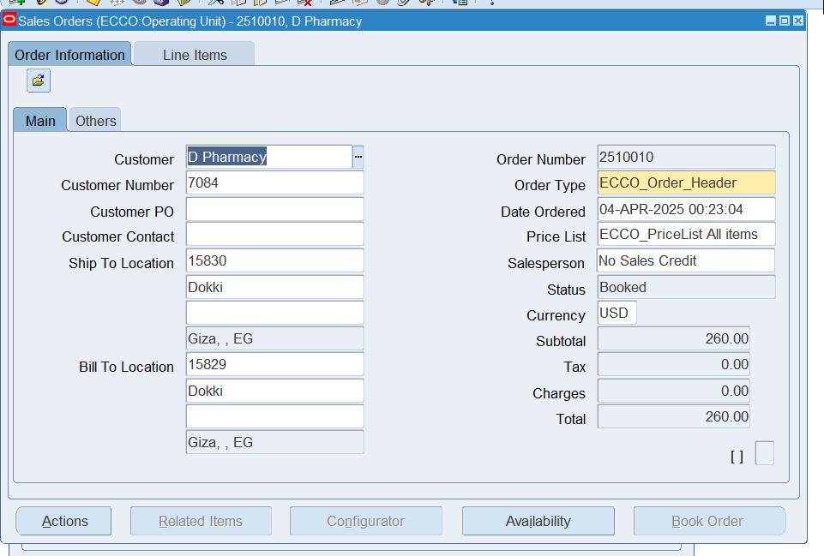
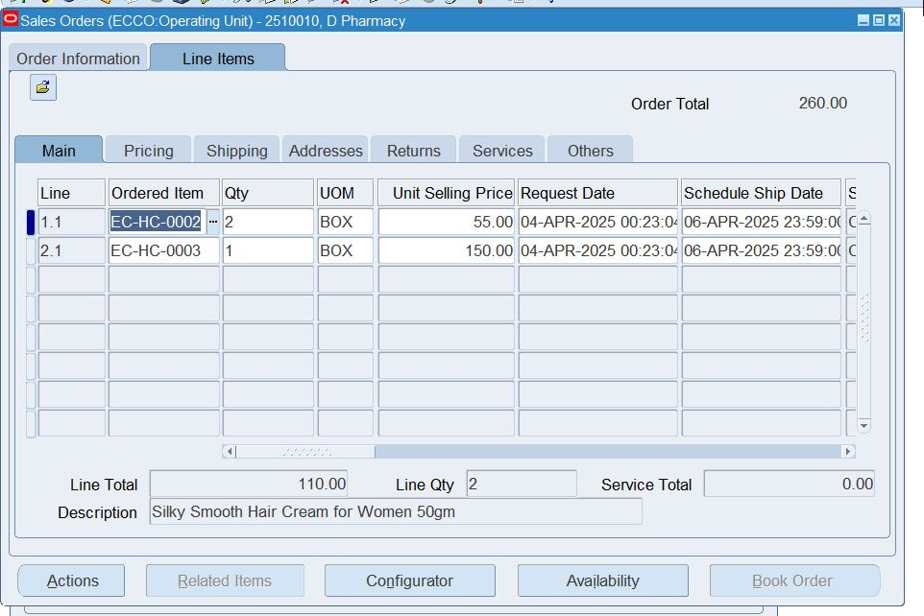
Oracle Applications - EBSDB

Slide 19
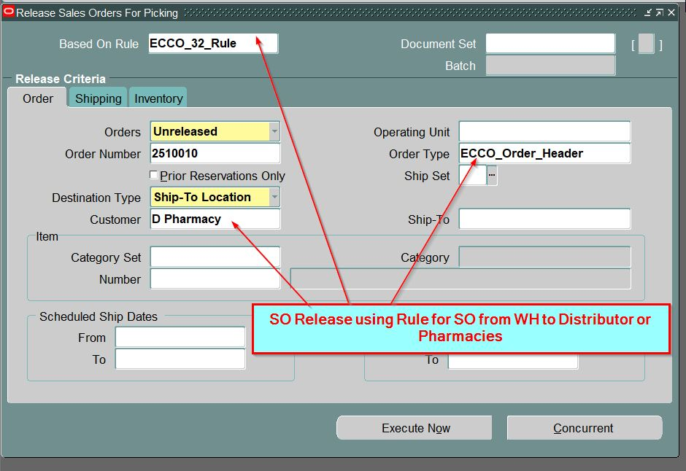
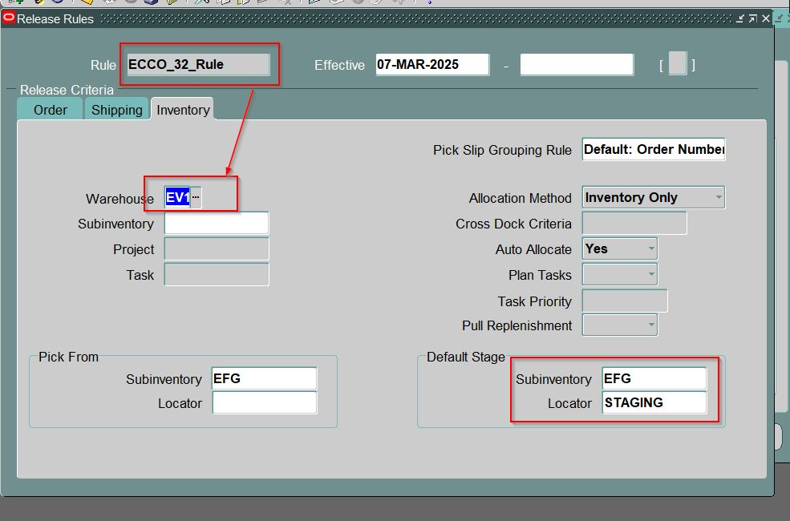
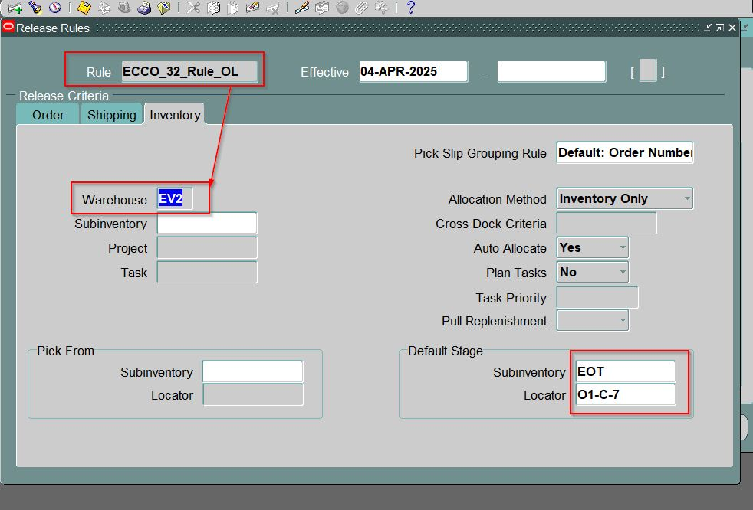
Oracle Applications - EBSDB

Slide 20
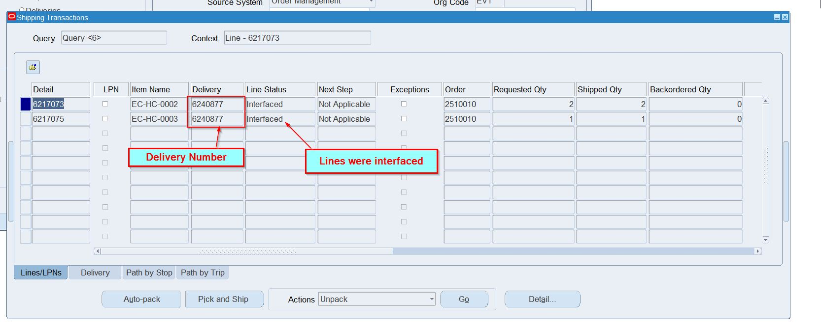
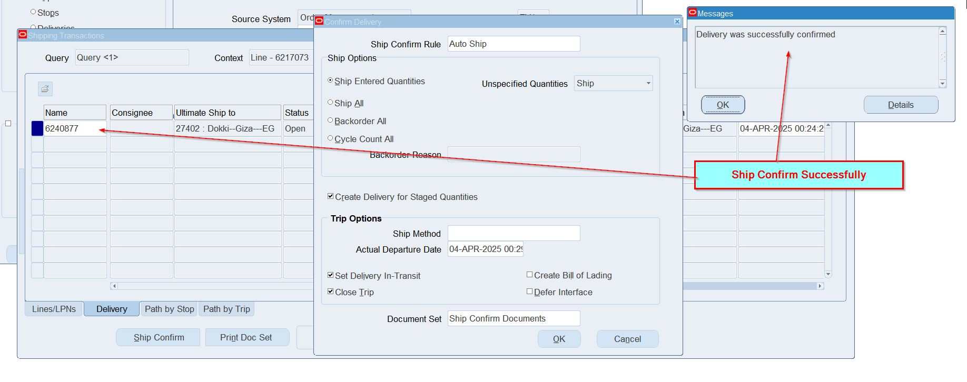

Slide 21
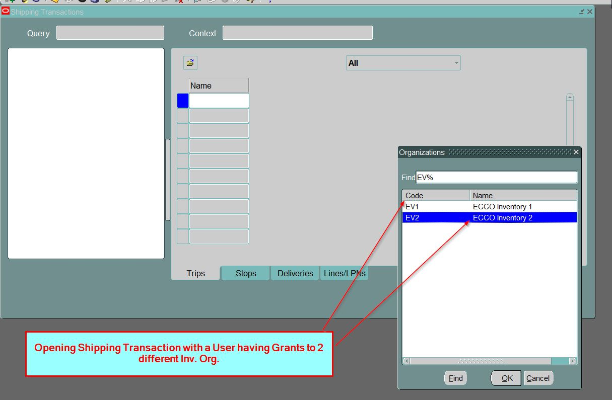
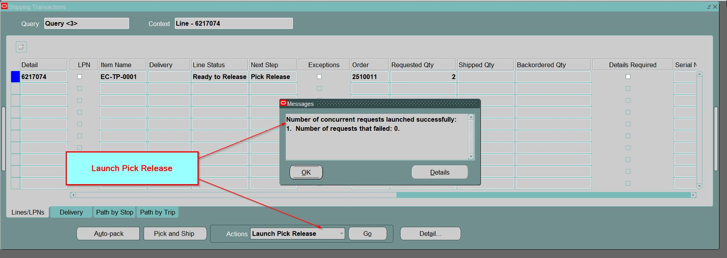

Slide 22
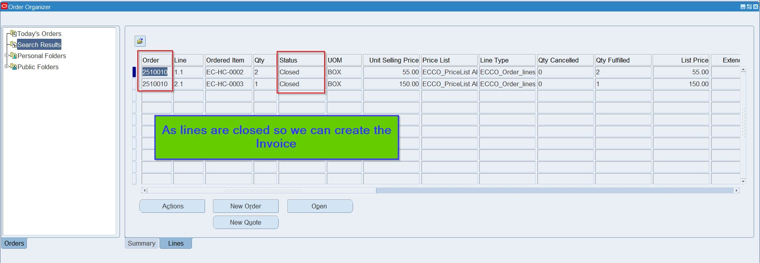

Slide 23
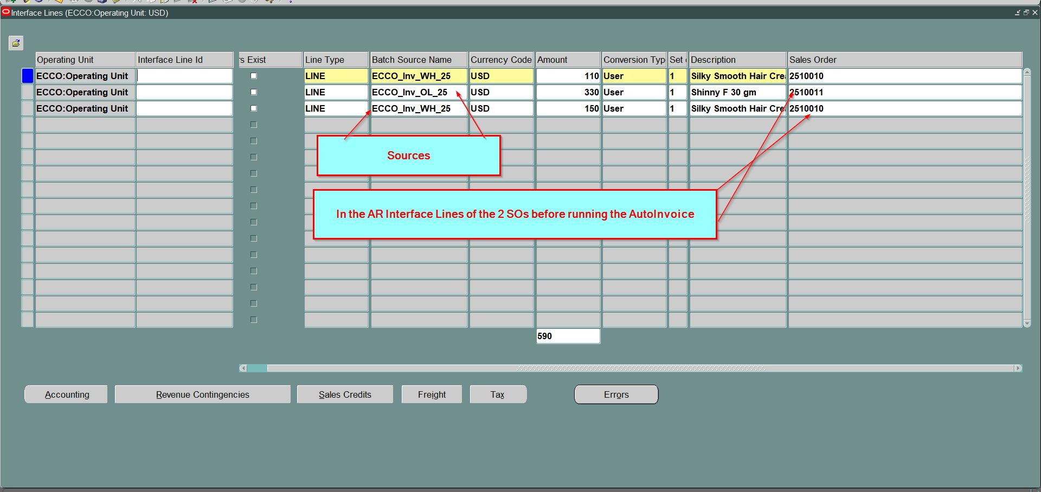
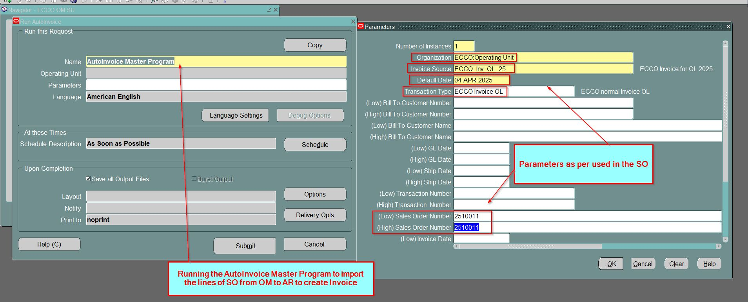

Slide 24
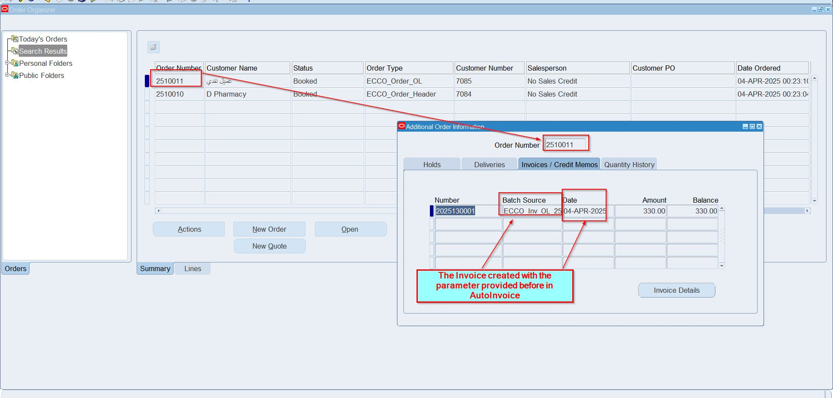
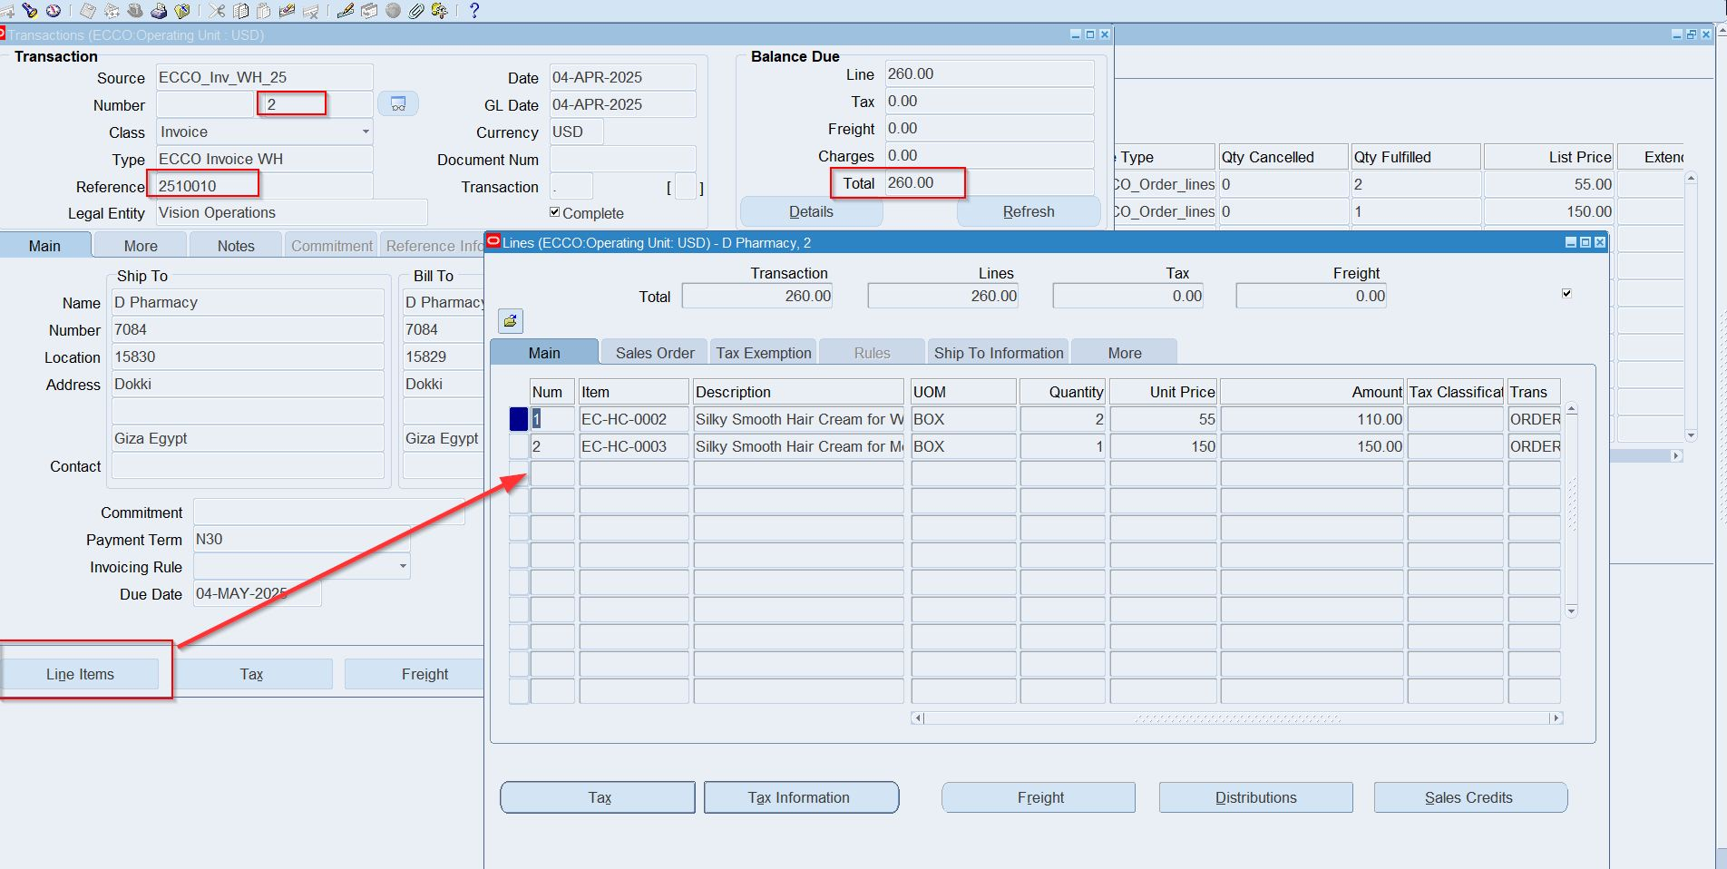

Slide 25
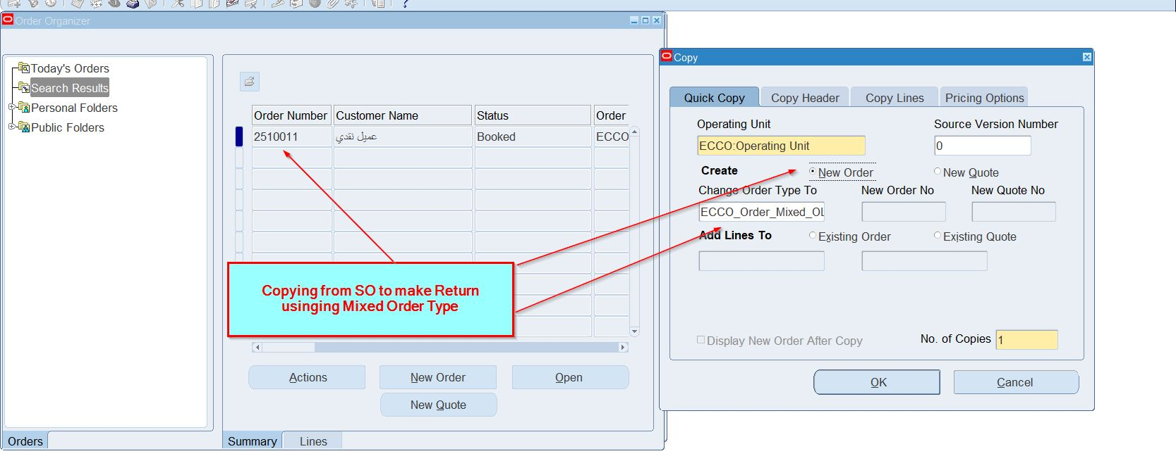
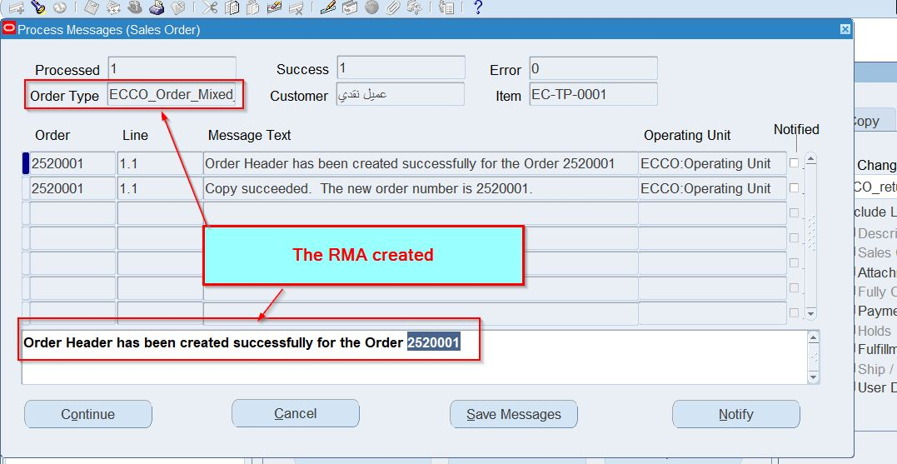
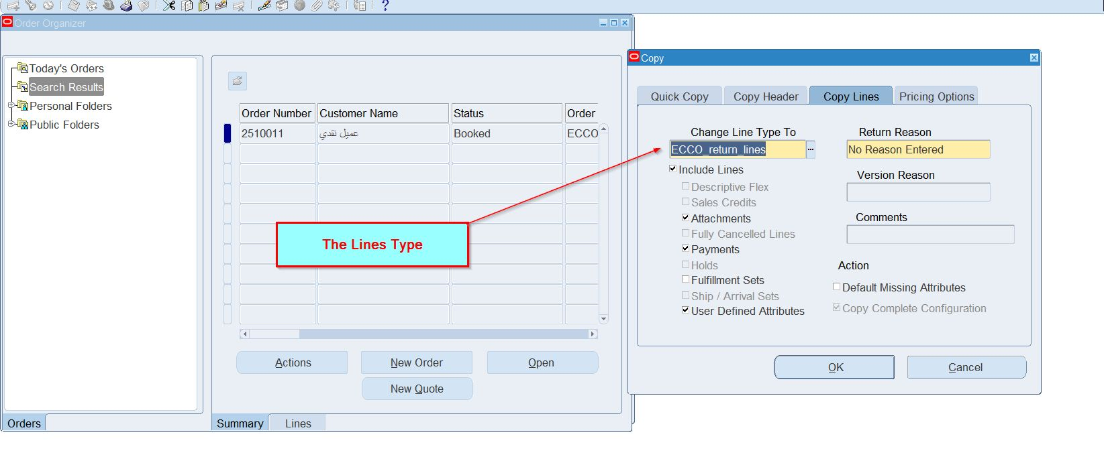

Slide 26
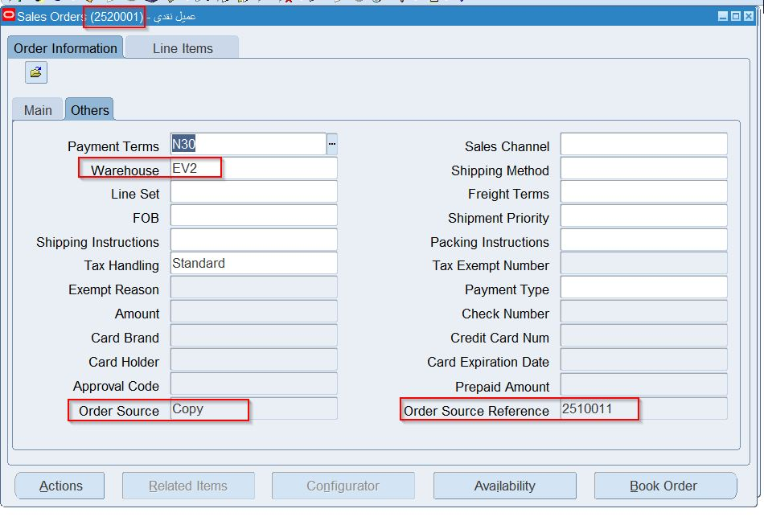
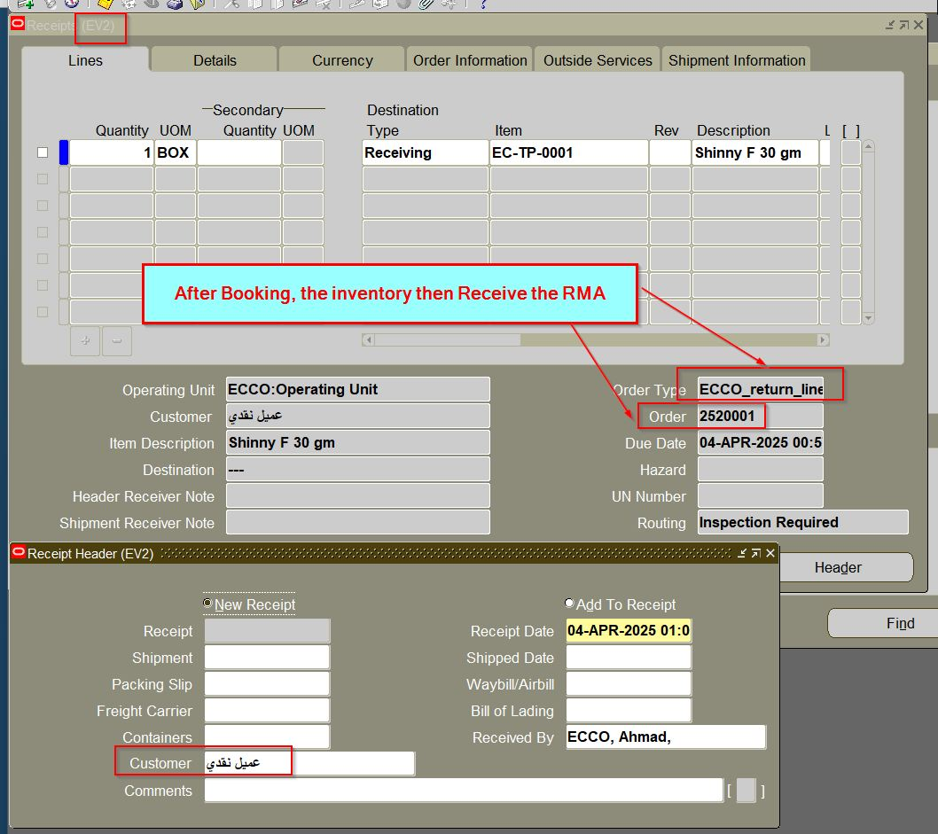
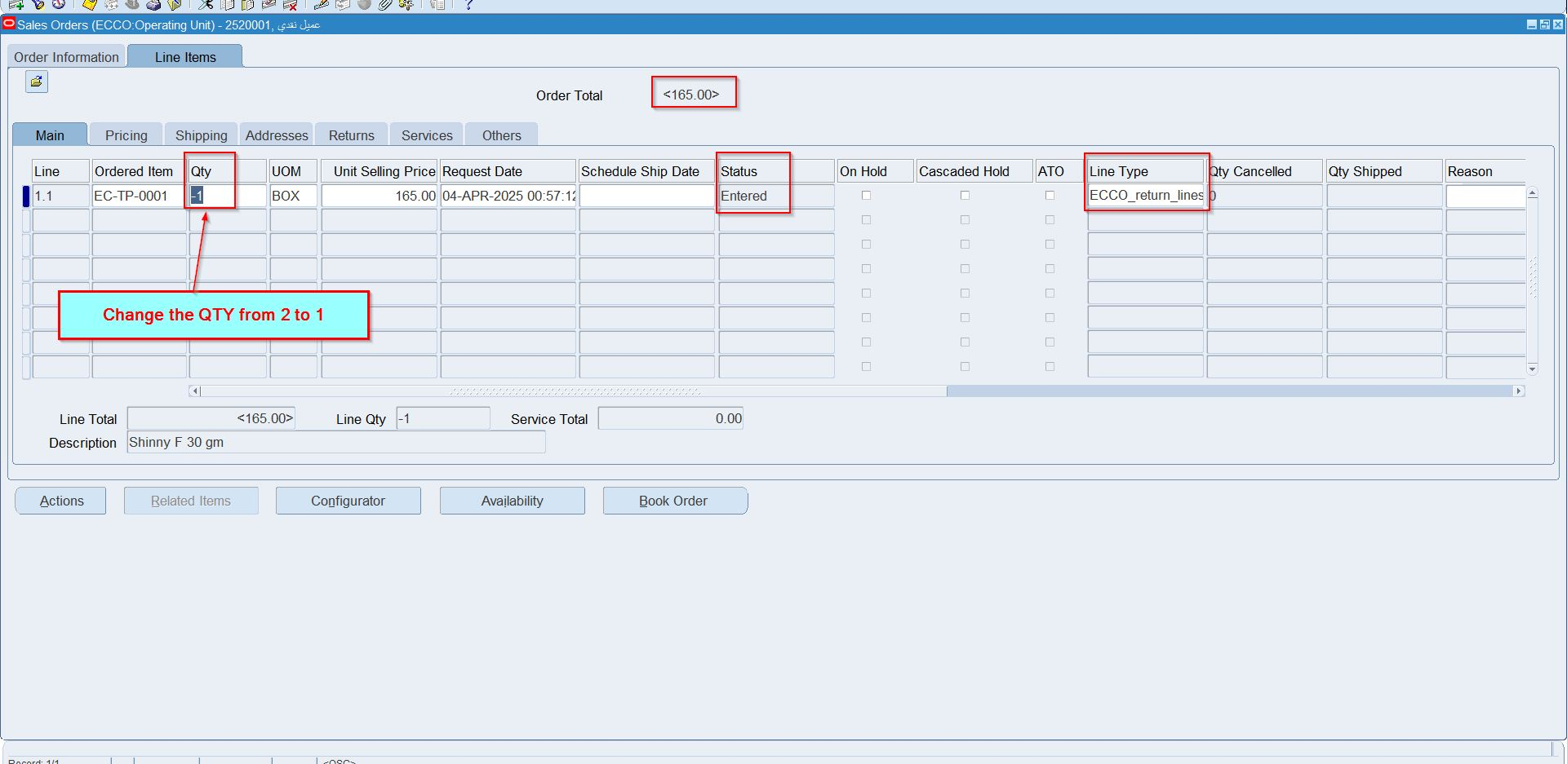

Slide 27
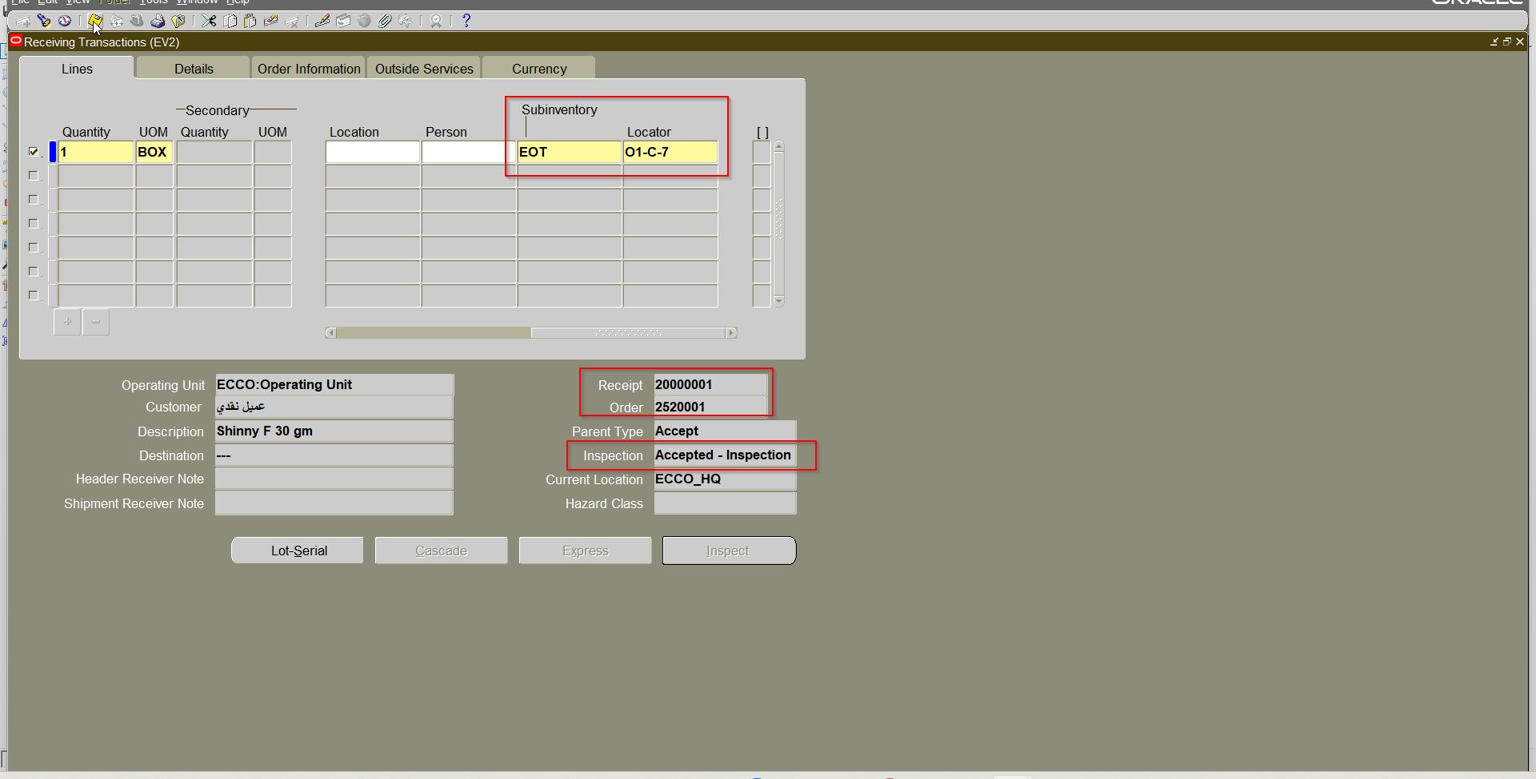
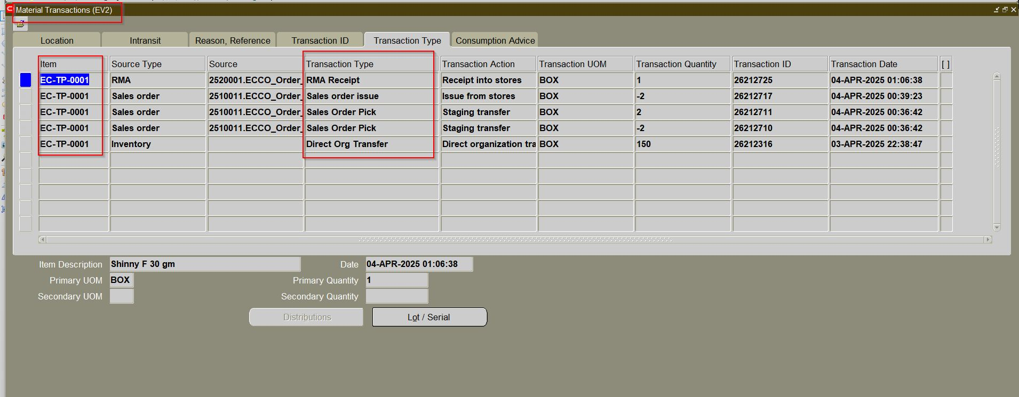

Slide 28
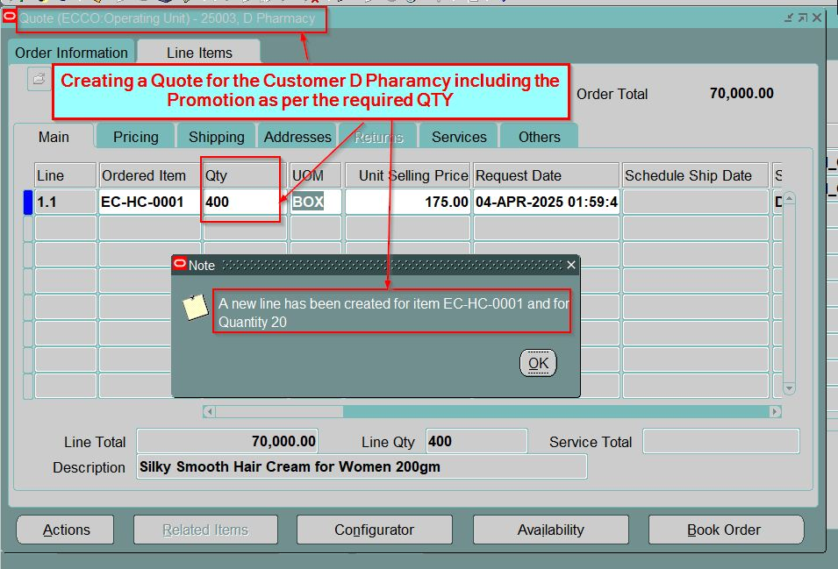
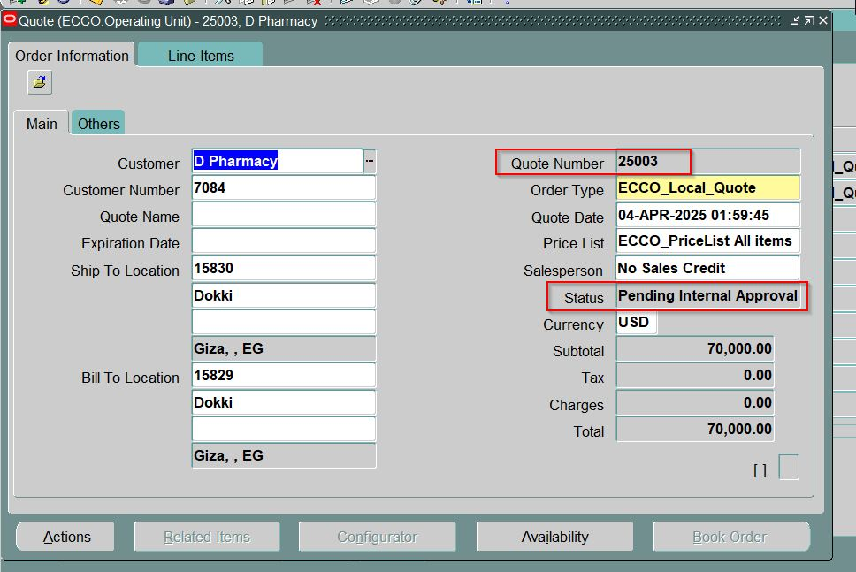

Slide 29
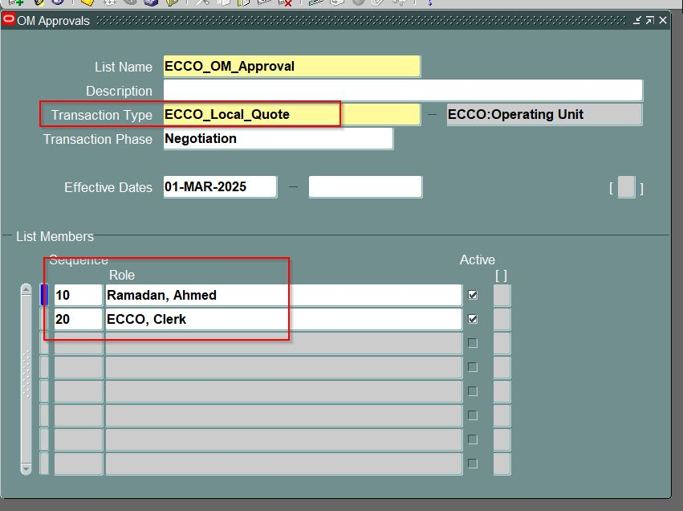
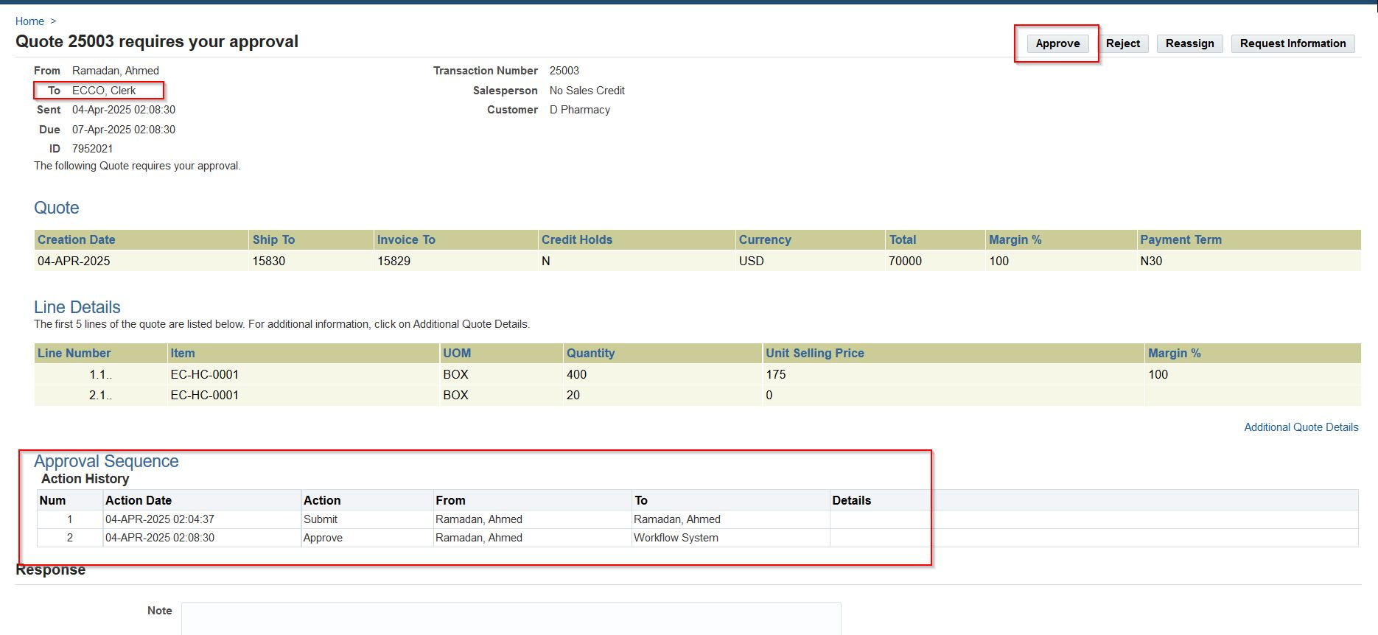
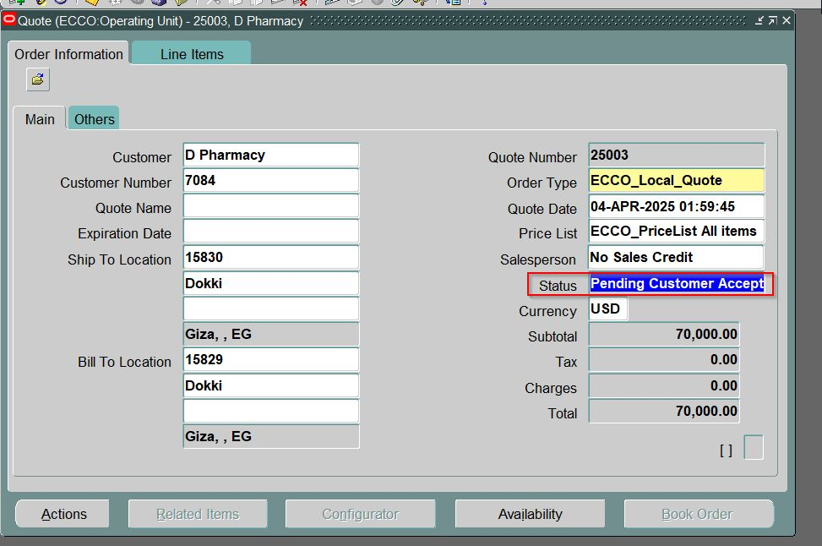

Slide 30




Slide 31



Slide 32


Slide 33



Slide 34


Slide 35



Slide 36
Testing, Validation & User Training
Testing Phases
Training & Change Management
Unit Testing
Role-based training and communication plan.
System Testing
Train-the-trainer model to support users.
User Acceptance Testing

Slide 37



Conclusion: Transforming Cosmetics
Customer Satisfaction
1
Enhanced by automated processes
Increased Profitability
2
From reduced costs
Efficiency and Compliance
3
Improved operations
Oracle ERP is a powerful solution. Automating processes improves cosmetics operations. A strategic investment ensures success. It will help thrive in a competitive market.

Slide 38

Post-Implementation Support & Optimization
Ongoing Support
Continuous Improvement
Help desk, system monitoring, and updates.
Gather feedback and add new features.
Stay Current
Implement best practices and regular tuning.

Slide 39

Next Steps & Call to Action
Follow-Up Meeting
In 2 weeks
Customized Plan if required
Contact Us
Partner for successful transformation.

